Slide 1
Tests of Hardened
Concrete

Slide 2
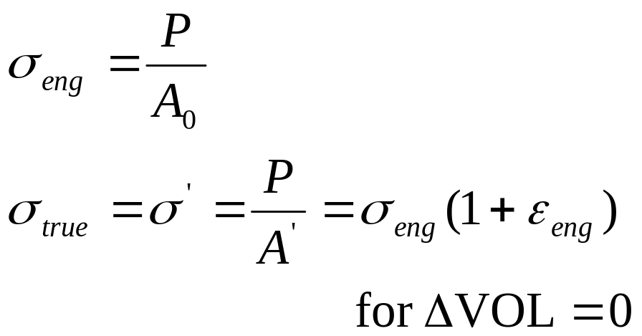
Stress
Balance for equilibrium
  loads = external forces
  internal forces = stress
Axial tension

Slide 3
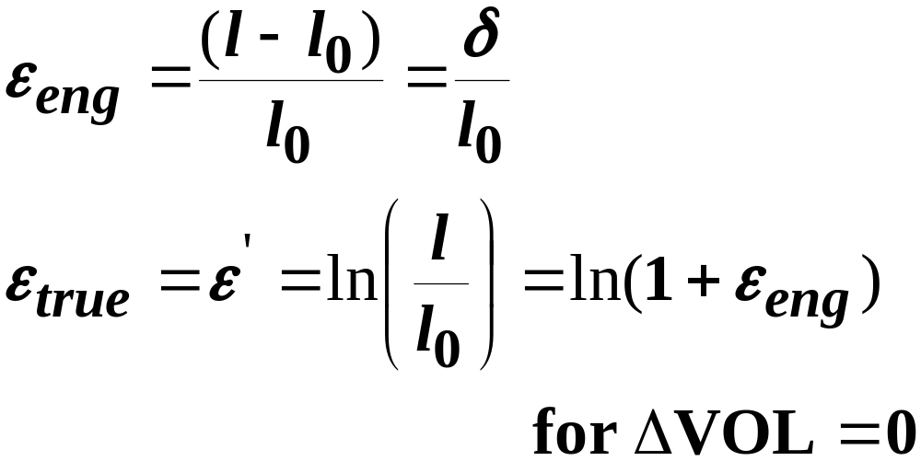
Strain
deformation (elastic or permanent)
  load
  change in temperature
  change in moisture
unit deformation = strain
Axial

Slide 4
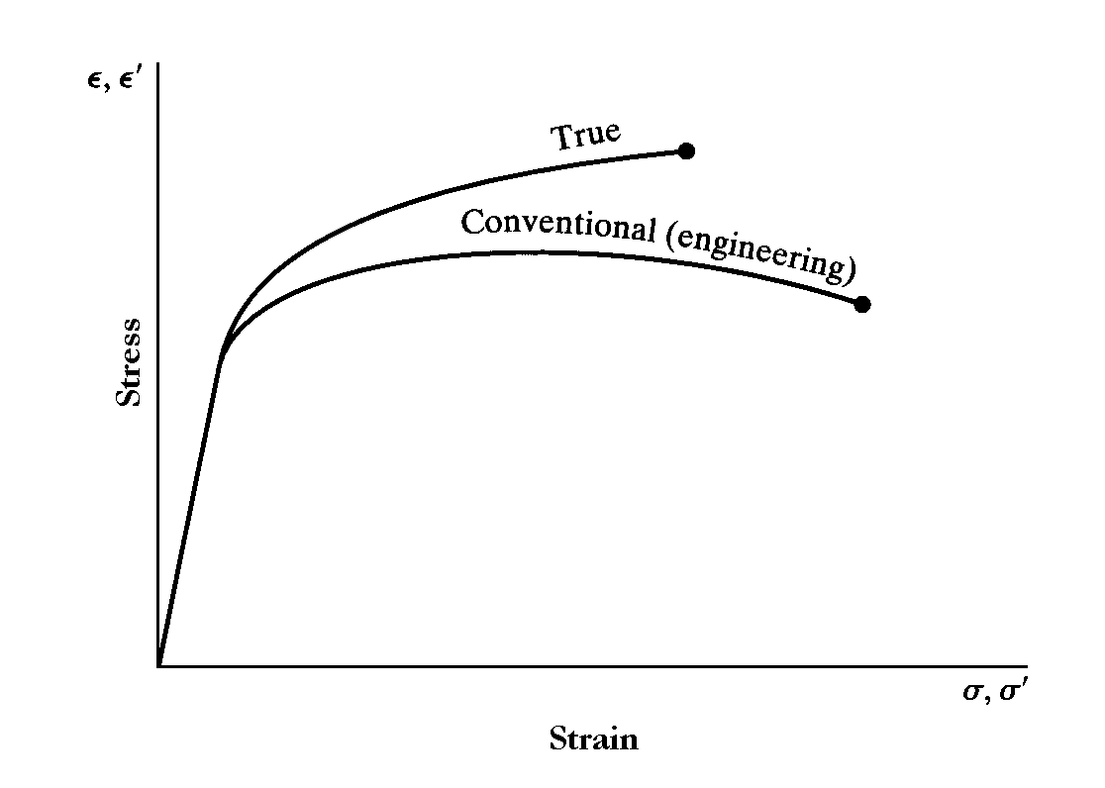
Strain

Slide 5
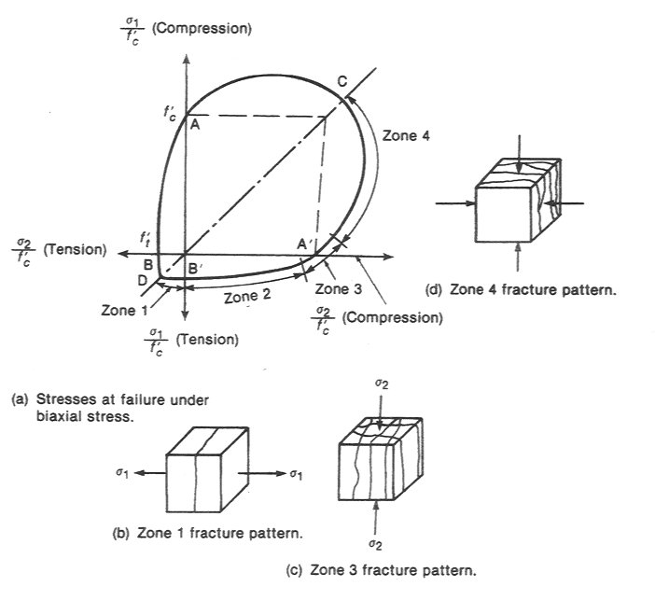
Strength
Envelope
For Concrete

Slide 6
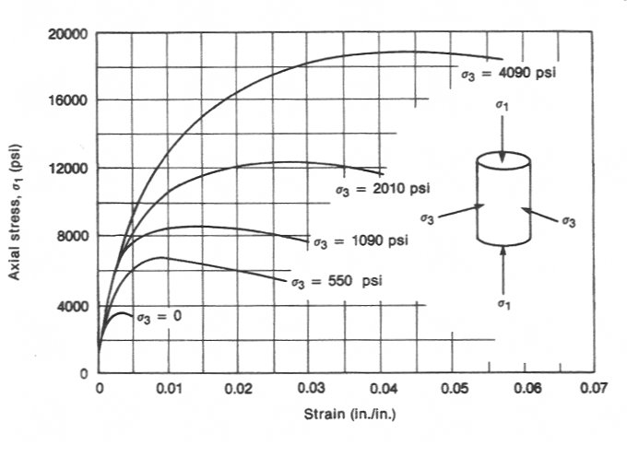
Effect of Confinement

Slide 7
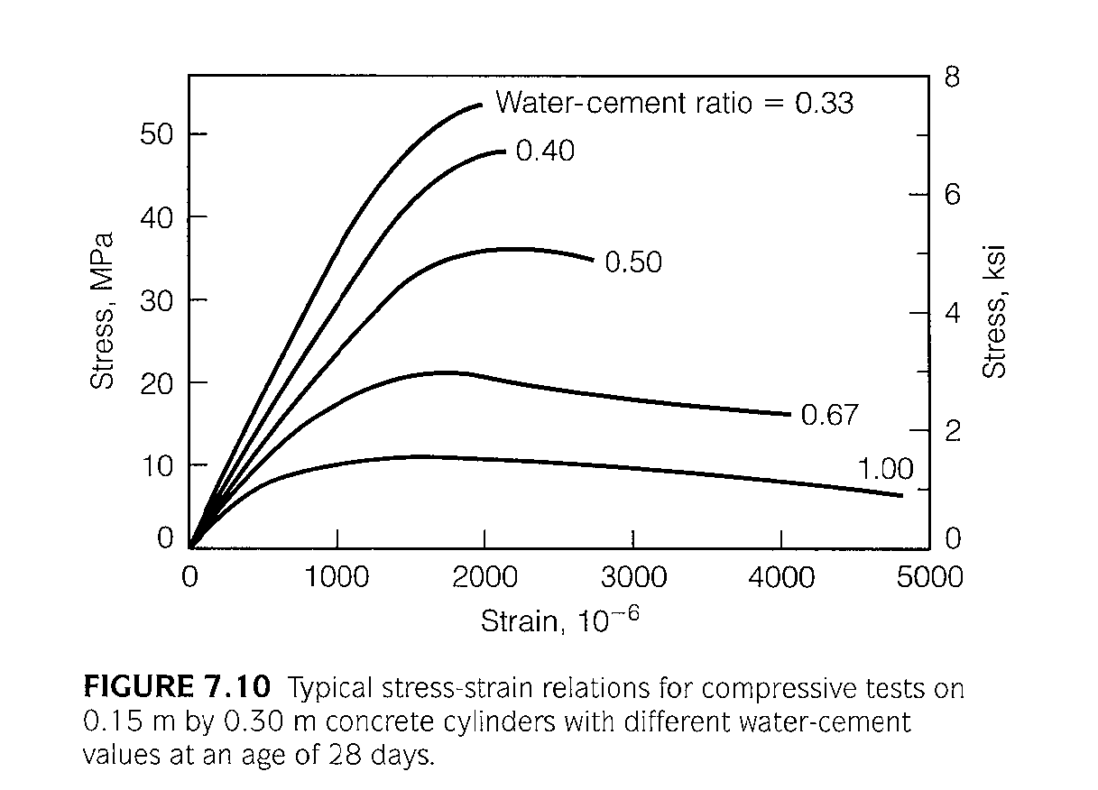
Affect of Water Cement Ratio

Slide 8
Compressive Testing
brittle
stronger in compression
cross-sectional area
cylindrical, cube
ends must be plane & parallel
end restraint apparently higher strength
Notes:
1) Tensile stresses at the ends of the specimen may cause tensile splitting failure perpendicular to the direction of loading.
2) Barrelling effect changes the length/diameter ratio.

Slide 9
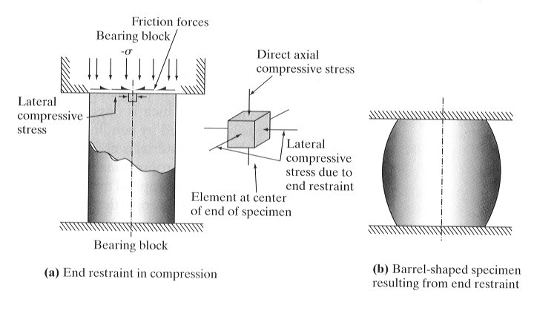
Loaded Compressive Specimen

Slide 10
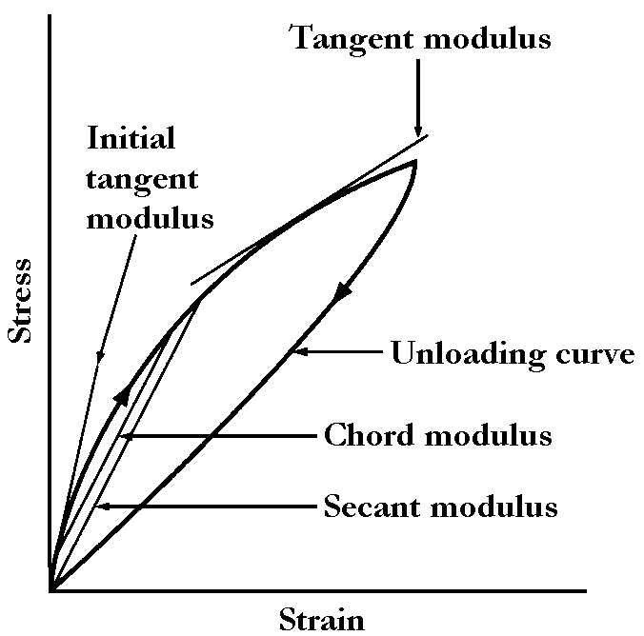

Elastic Properties
E = modulus of elasticity = Young’s modulus = slope
Linear Elastic
Nonlinear Elastic
Strain energy per unit volume = area
Stress
(σ)
E
1
Strain (ε)

Slide 11
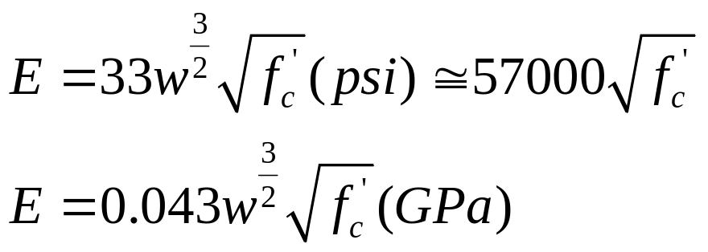
Elastic Properties
Poisson’s ratio =- (radial strain/axial strain)

Slide 12
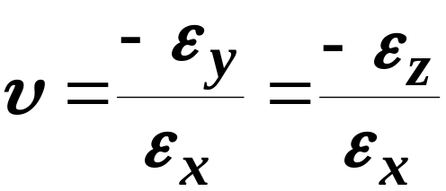
Poisson’s Ratio (υ)
ratio of lateral strain to axial strain
0.15 to 0.50
  steel 0.28
  wood 0.16
  granite 0.28
  concrete 0.1 to 0.18
  rubber 0.50
axial
deformed

Slide 13
Flexure (Bending)
Compression
Neutral
Axis
Tension
How would the cross-section deform?

Slide 14
Flexure (Bending)
Compression
Neutral
Axis
Tension

Slide 15
Laboratory Measuring Devices
Dial gage:
  Measure relative deformation between two points.
  Two different pointers: one division of small pointer corresponds to one full rotation of the large pointer.

Slide 16
Laboratory Measuring Device
Linear Variable Differential Transformer (LVDT)
  Electronic device for measuring small deformations.
  Input voltage through the primary coil
  Output voltage is measured in the secondary coil
  Linear relationship between output voltage and displacement.
zero voltage
Secondary
coil
Primary
coil
Secondary
coil
Shell attached
to point A
Core attached
to point B

Slide 17
LVDT Schematic
zero voltage
Secondary
coil
Primary
coil
Secondary
coil
Negative voltage
Positive voltage

Slide 18
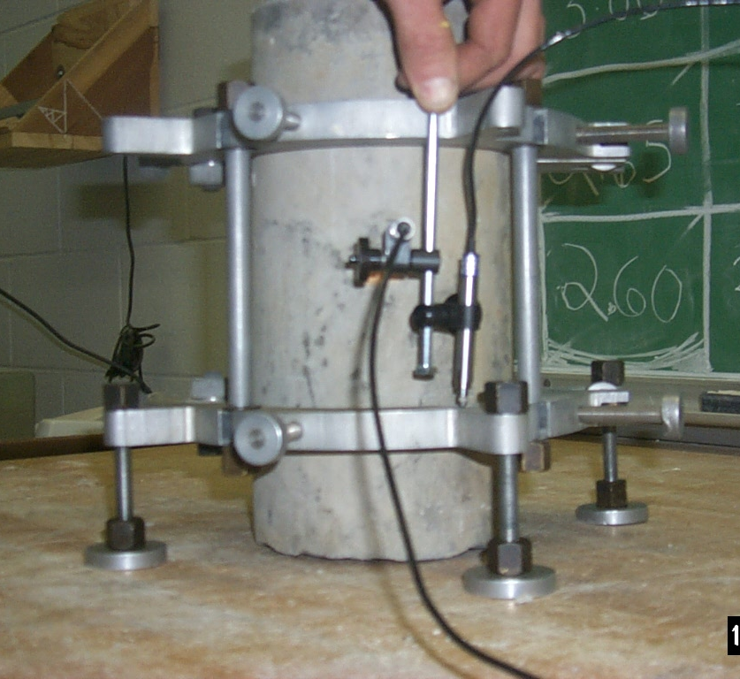
Longitudinal Displacement
Gage length
LVDT

Slide 19
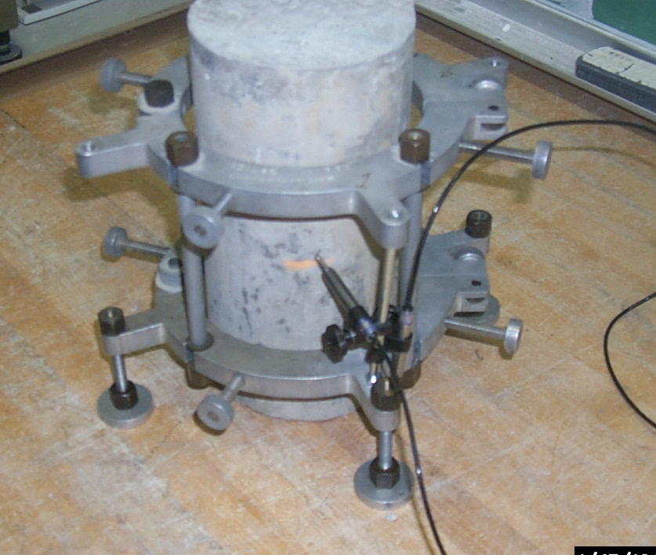
Radial Displacement
LVDT

Slide 20
Electrical Strain Gage
Measure small deformation within a certain gage length.
A thin foil or wire bonded to a thin paper or plastic.
The strain gage is bonded to the surface for which deformation needs to be measured.
The resistance of the foil or wire changes as the surface and the strain gage are strained.
The deformation is calculated as a function of resistance change.
wire
Surface

Slide 21
Load Cell
Electronic force measuring device.
Strain gages are attached to a member within the load cell.
An electric voltage is input and output voltage is obtained.
The force is determined from the output voltage.
Strain gages
Strain gages

Slide 22



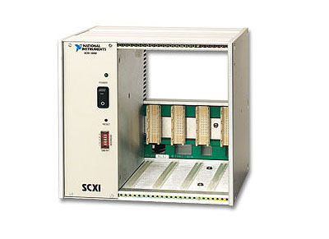
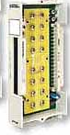


Data Acquisition Setup
8 Channel LVDT
Input Module
8 Channel Universal Strain/Bridge Module
2 Voltage Inputs from the controller (Stroke LVDT, and Load Cell)
6 strain Gauges

Slide 23
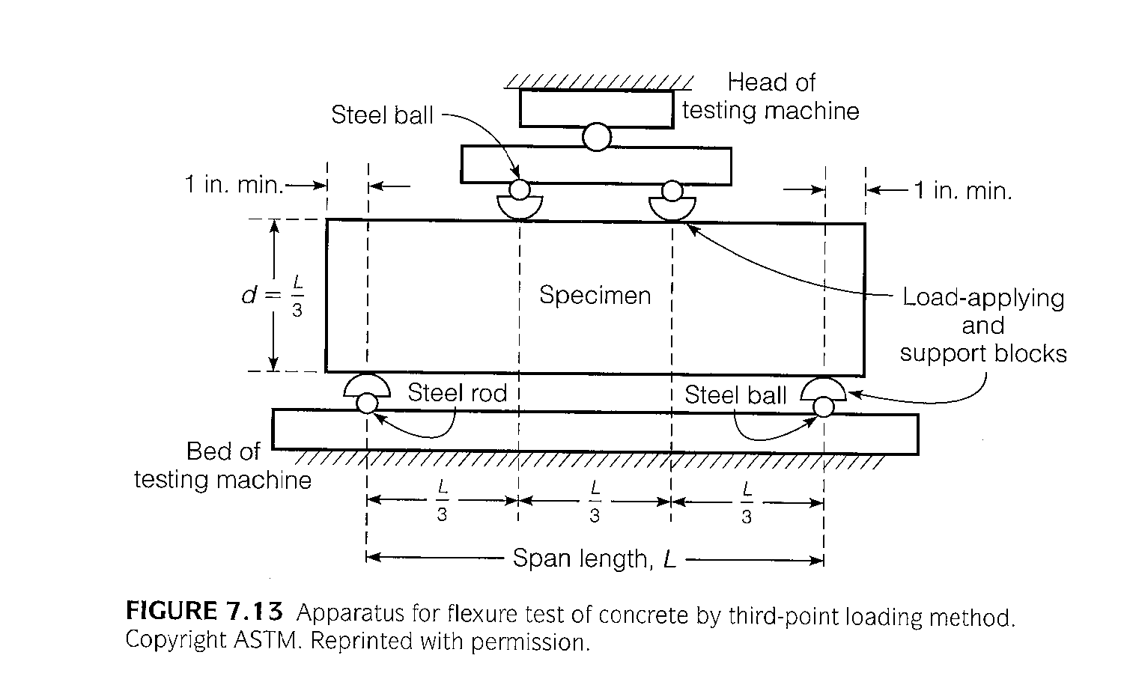
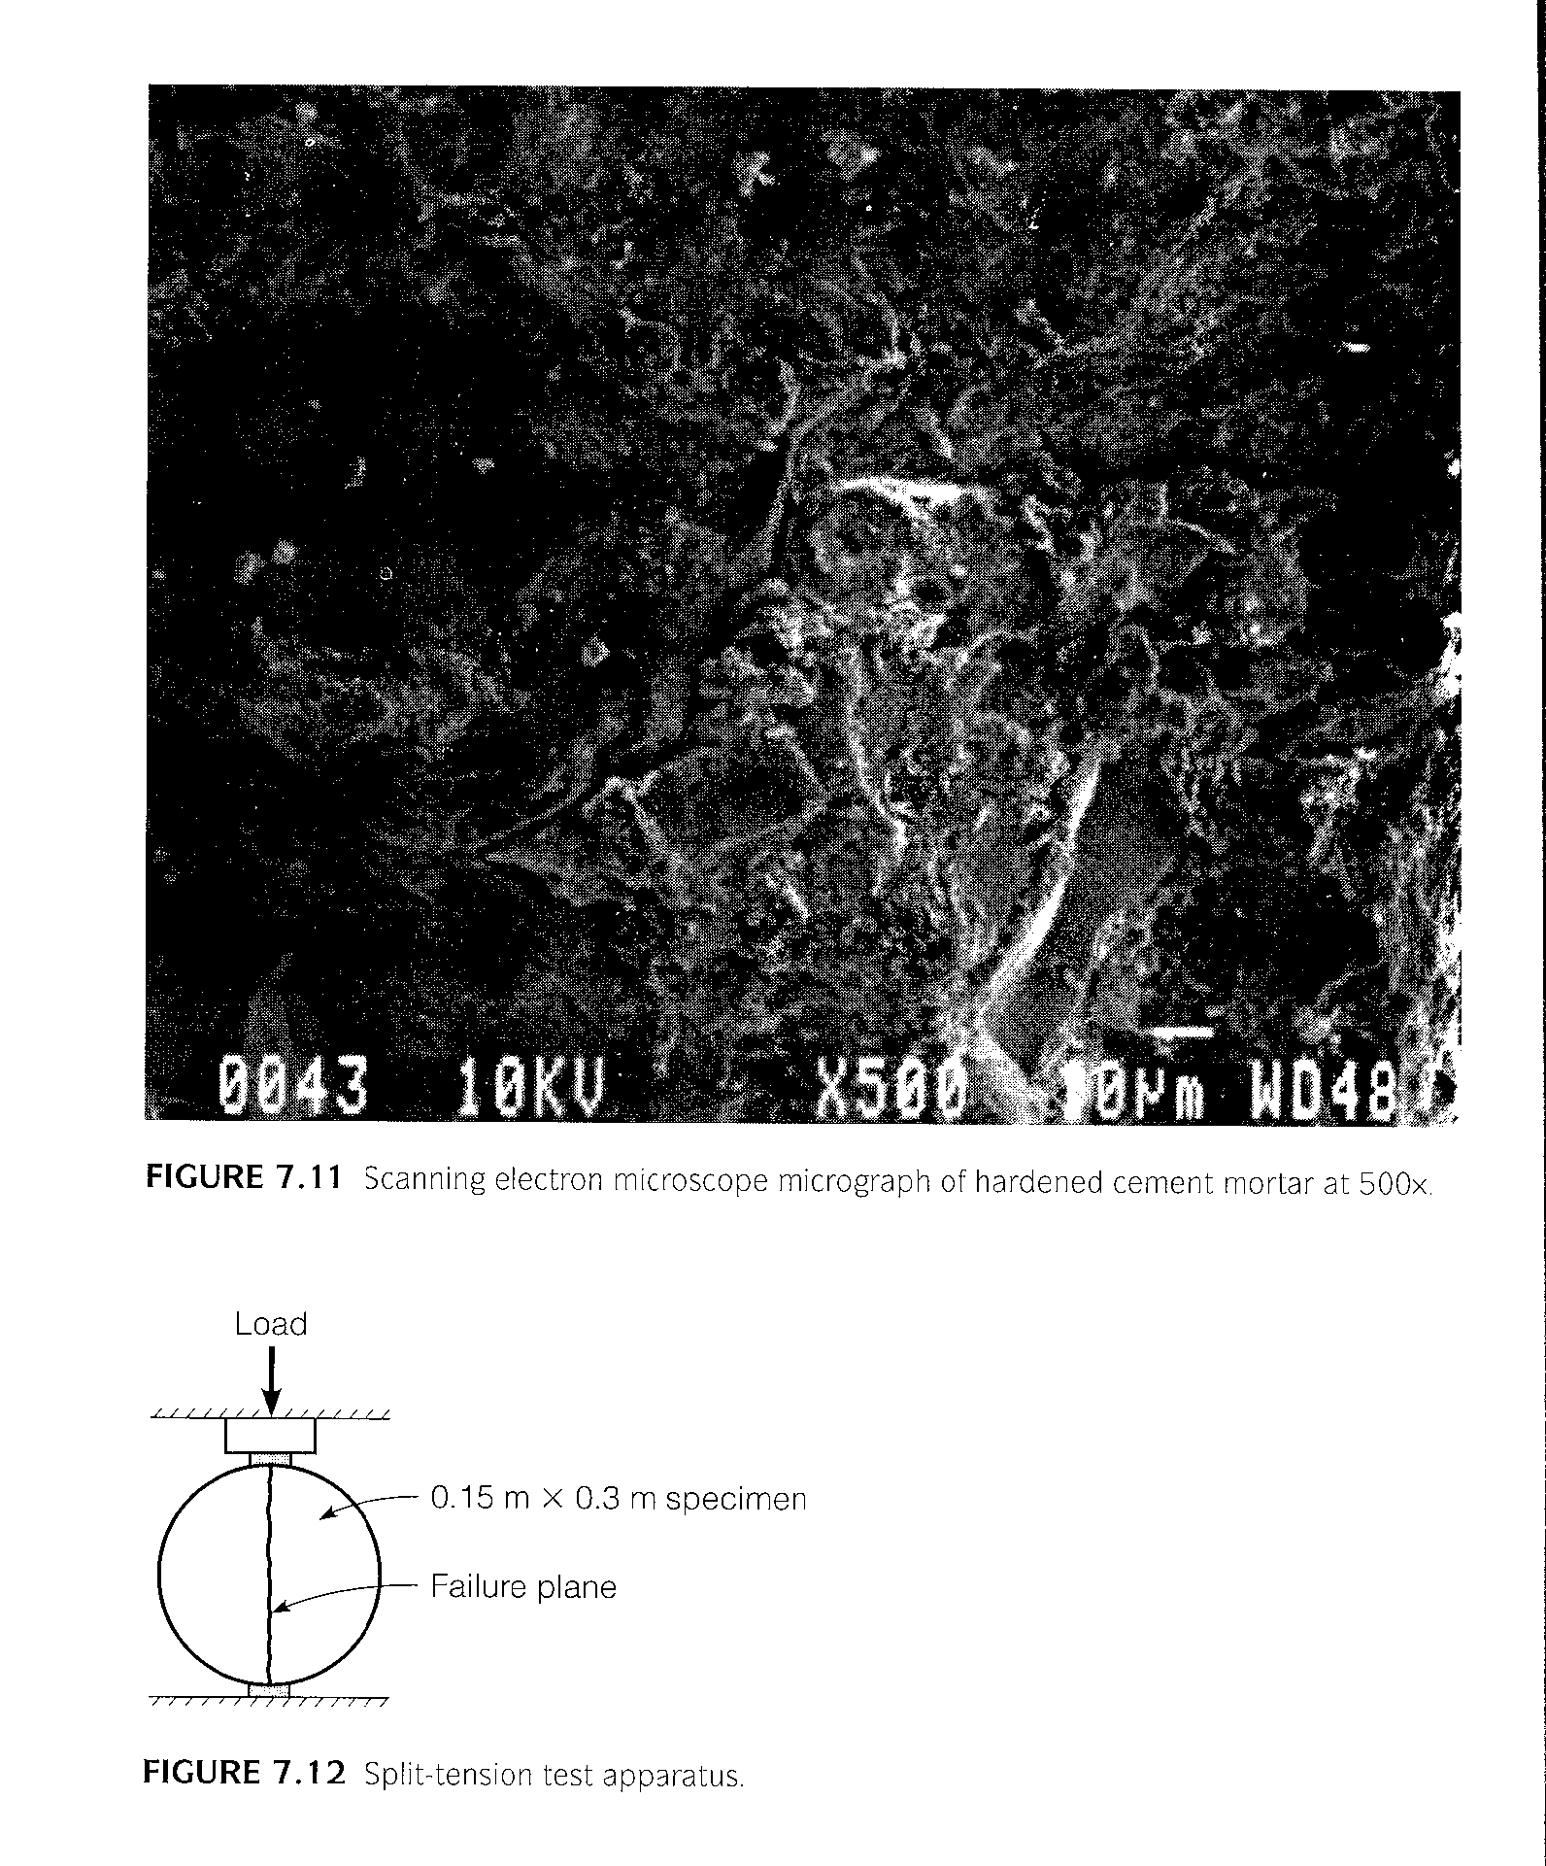
Strength

Slide 24
Tensile Testing
Indirect: brittle
  cylindrical
  splitting tension / diametral compression
Direct: ductile
  cylindrical, prismatic
  reduced section @ center
Test Parameters
  surface imperfections
  rate of loading
  temperature (ductile)
  specimen size
σ_{c}
σ_{t}

Slide 25
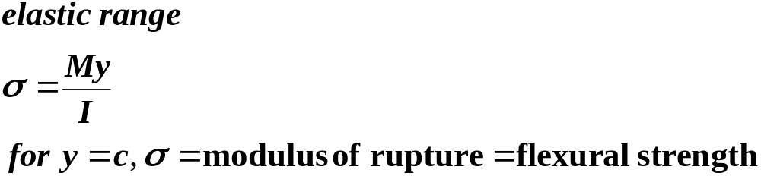
Flexure (Bending)
Compression
Neutral
Axis
Tension

Slide 26
Flexural Testing
Three-point
(center point)
  smaller specimens
  higher flexural strength (size effect)
  shear may be a factor
General
  shear effects ignored as long as l/d > 5
  apply load uniformly across width
Four-point
  constant moment, no shear in center
  localized loading stresses (3 vs. 4 pt)
  load symmetrically
Notes:
The difference in 3 point bending and 4 point bending is 25%.
Shear effects tends to cause greater deflection and back-calculation of lower elastic modulus. (as would be the case in shorter beams).

Slide 27
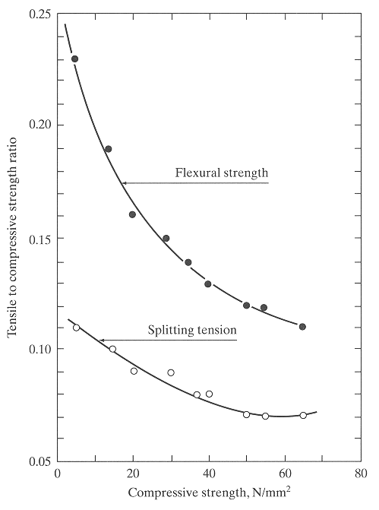
Correlation of Concrete Strengths
Notes:
Concrete permeability, porosity, and density affect strength.
Concrete is stronger in compression than in tension. Often used with reinforcing steel to carry the tensile load after cracking has occurred.
Concrete strength also depends on the w/c and the degree of hydration. The degree of hydration depends on temperature and moisture of the concrete.

Slide 28
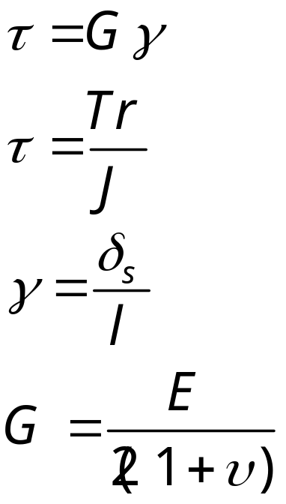
Torsion
  G=shear modulus
  T = torque, twisting moment
  J = polar moment of inertia
  γ = angle of rotation
  for isotropic materials
torque pure shear strain (γ)
cylindrical (radius r)
l
γ
δ_{s}
τ
τ

Slide 29
Standards & Standard Tests
allow comparison
ensure design = construction
standard specifications for materials
properties specified in design, measured with standard tests
Standards Organizations
  ASTM
  AASHTO
  ACI
  State Agencies
  Federal Agencies
  Other

Slide 30
Scanning Electron Microscope

Slide 31
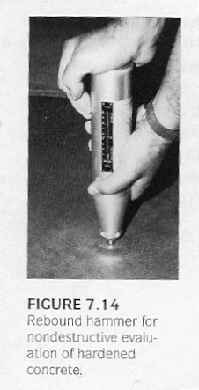
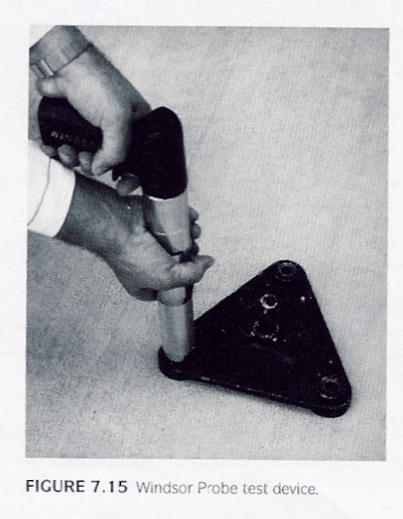
Impact Hammers

Slide 32
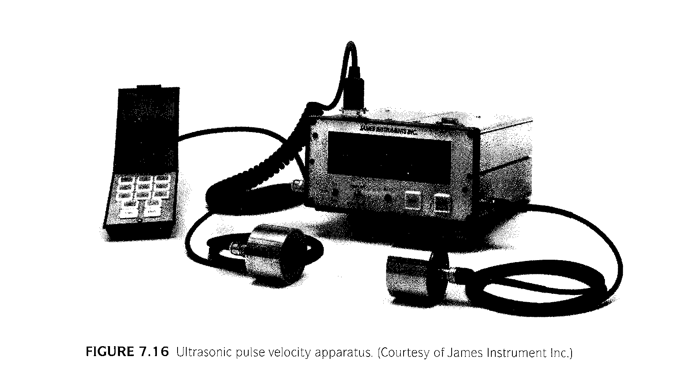
Ultrasonics

Slide 33
Pulse Velocity Testing
ASTM C 597
Velocity of sound wave from transducer to receiver through concrete relates to concrete strength
Develop correlation curve in lab
Precision to baseline cylinders: ±10%

Slide 34
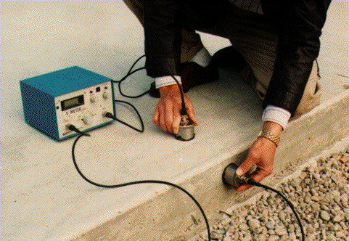
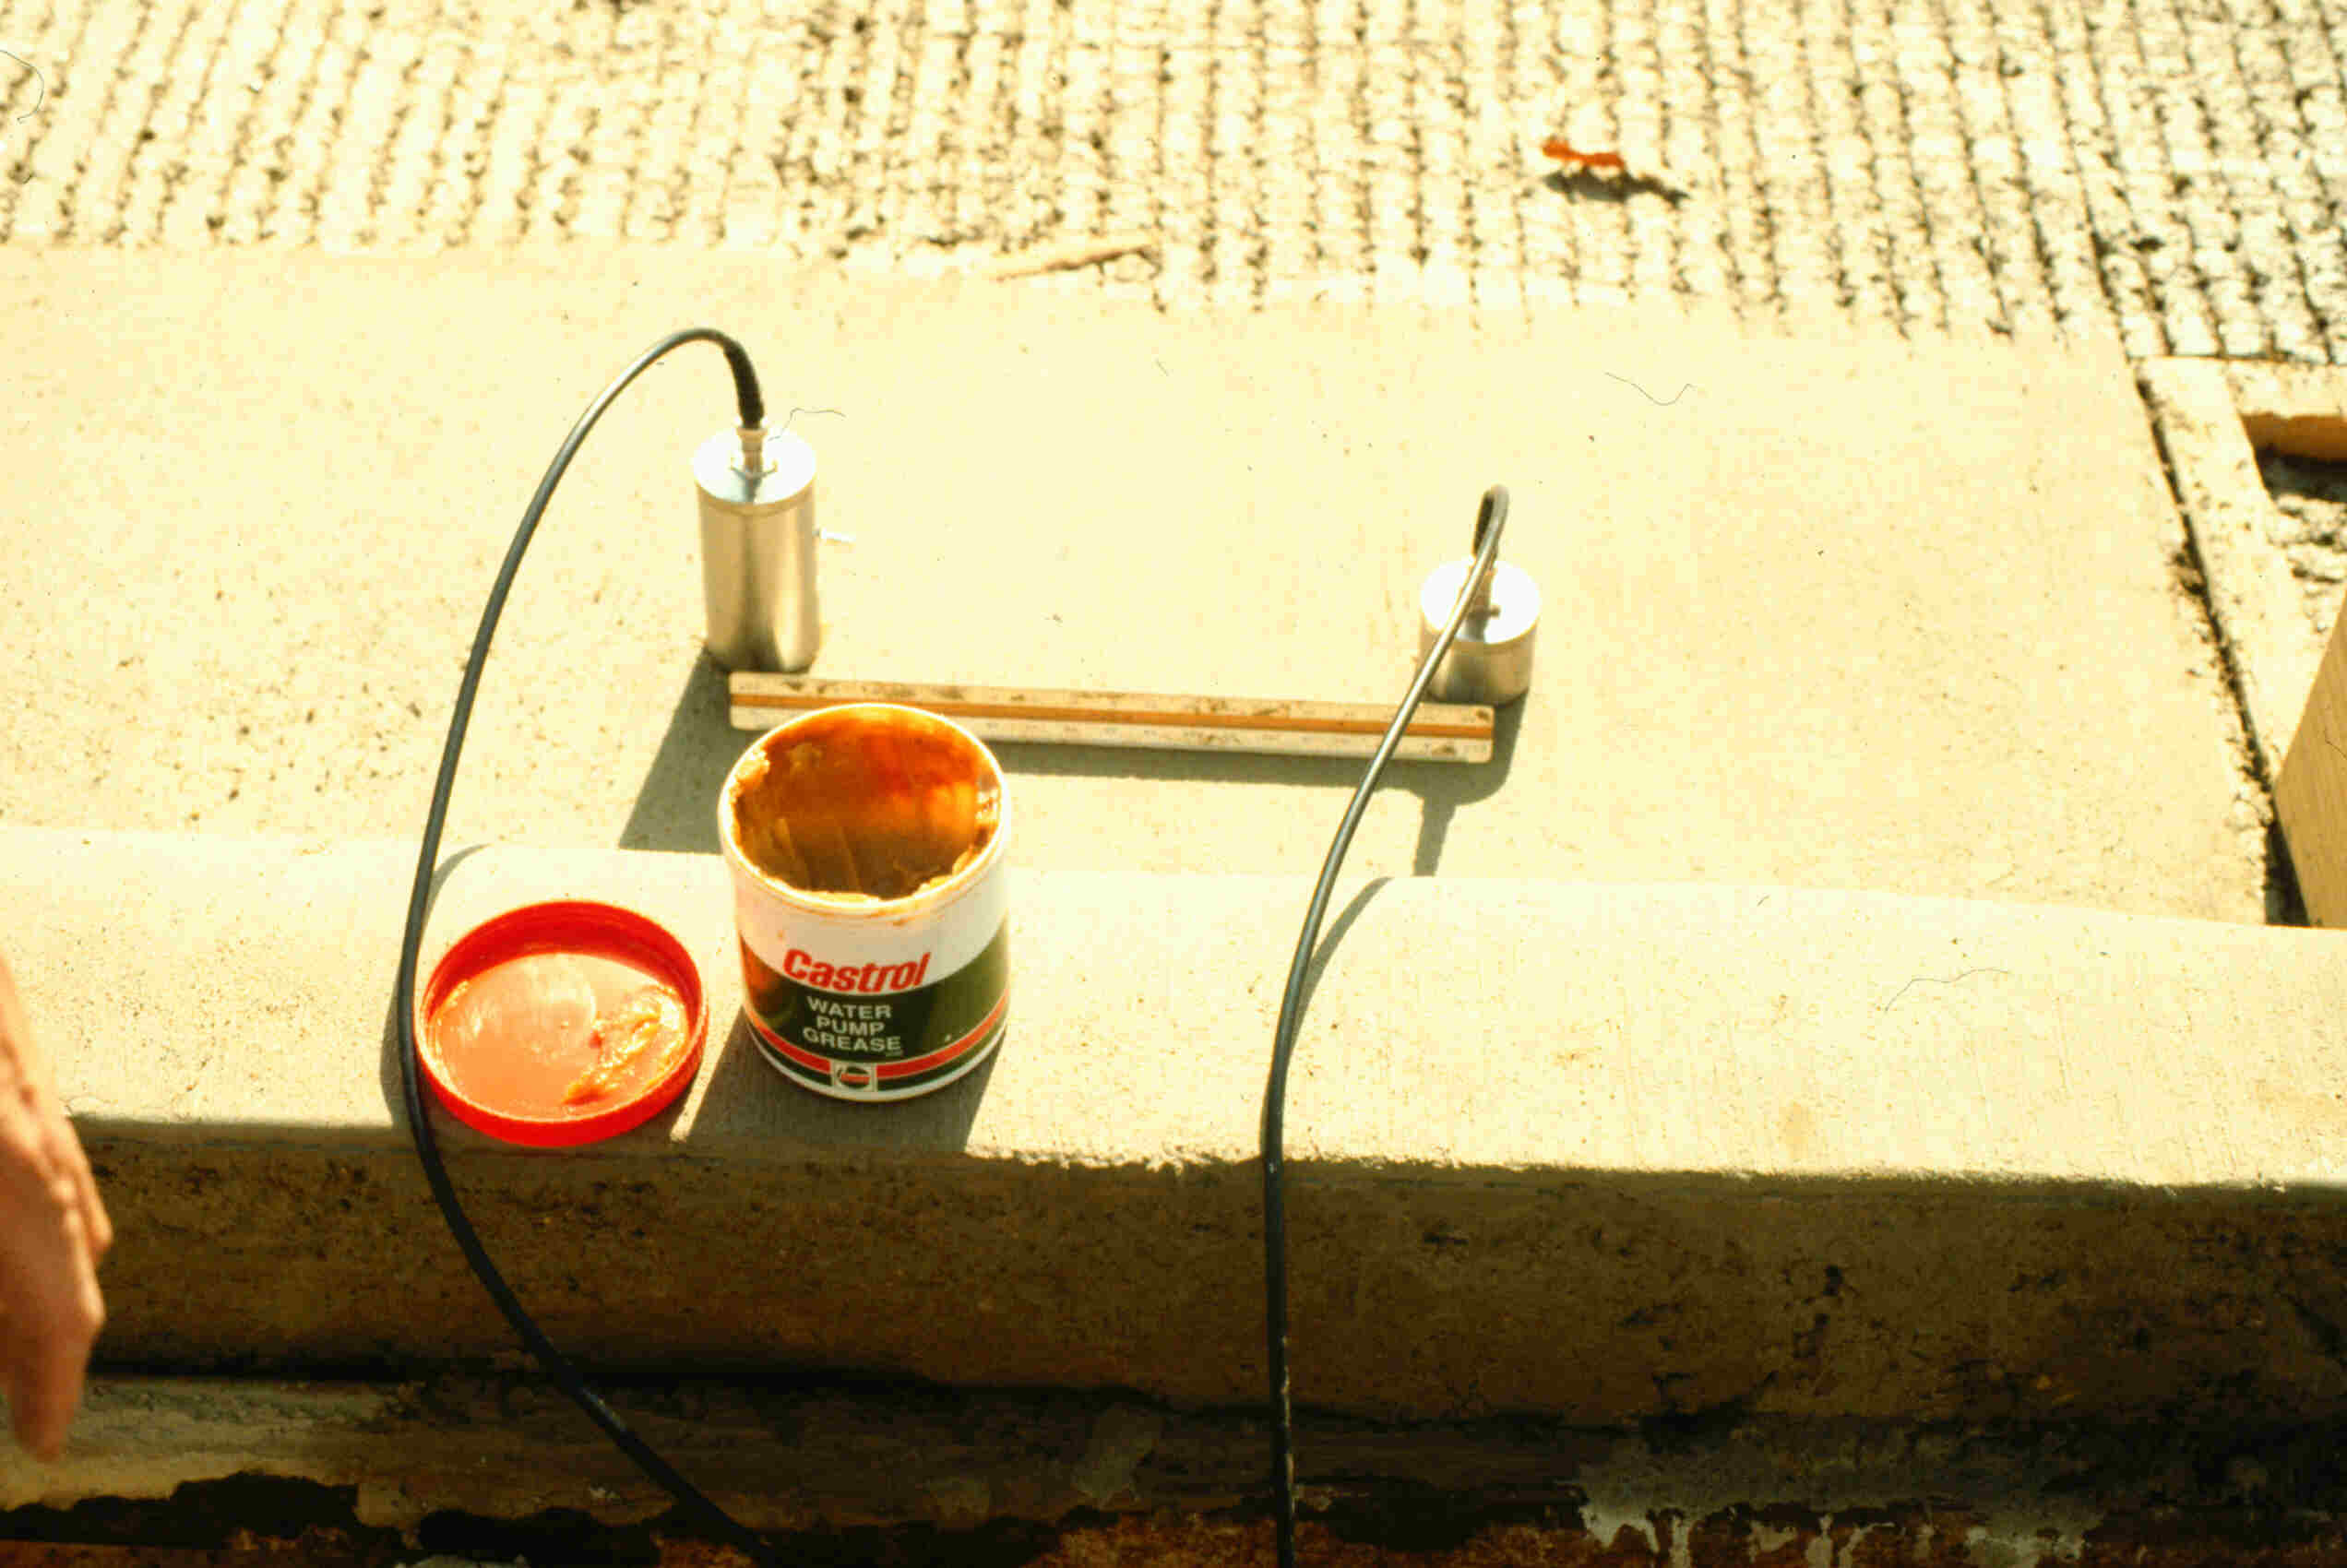
Pulse Velocity
12
10
1,500
8
1,000
6
Compressive Strength (MPa)
Compressive Strength (psi)
4
500
Semi-direct mode
2
0
0
2
4
6
8
10
12
14
(1000 ft/s)
0
1
2
3
4
Pulse Velocity (1000 m/s)

Slide 35
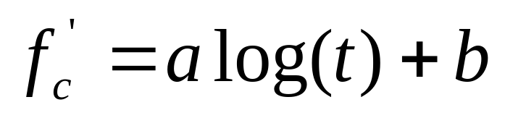

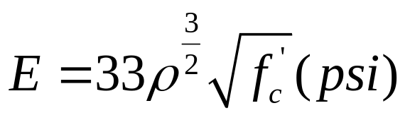
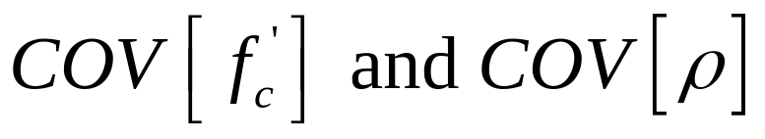
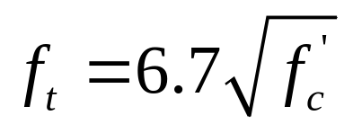
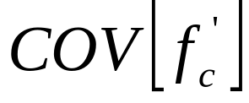
Concrete Strength Models
Compressive Strength
Modulus of Elasticity
Tensile Strength

Slide 36
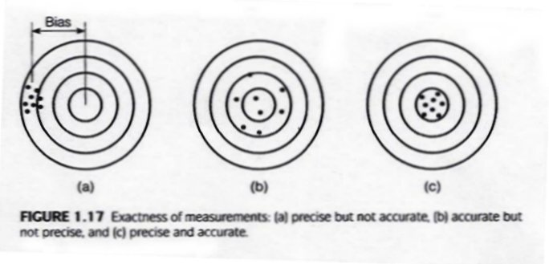
Hitting Target Strengths

Slide 37
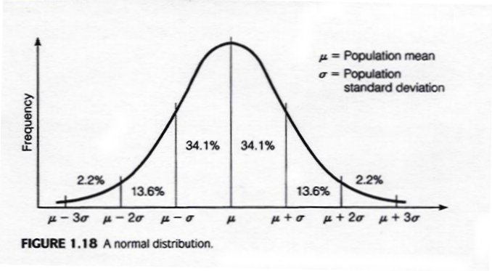
Variability of Strength

Slide 38
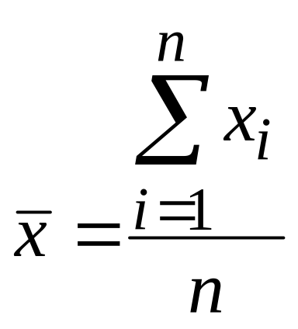
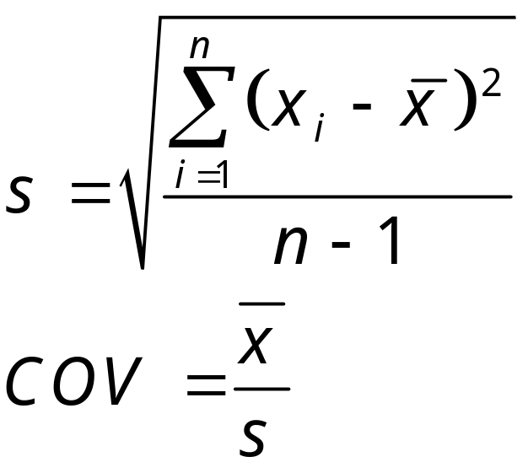
VARIABILITY
measured properties not exact
always variability
  material
  sampling
  testing
probability of failure
mean, standard deviation (s), coefficient
of variation (COV)

Slide 39
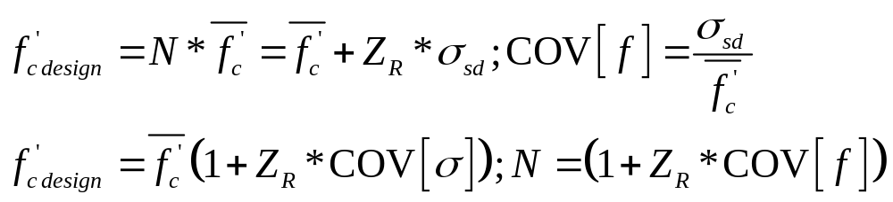
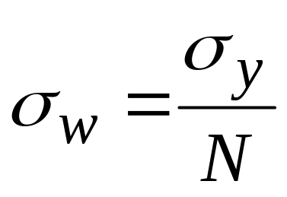
DESIGN / SAFETY FACTORS
design strength = f(material, construction variables)
working stress = f(σ_{y})
N = 1.2 to 4 = f(economics, experience, variability in inputs, consequences of failure)

Slide 40
Variability-Specification
Using the normally distributed tensile test data for concrete, determine the mean and standard deviation for both ΜοR & f_{t}. In order to maintain a 1 in 15 chance that f_{t} ≤ 320 psi, what average f_{t} must be achieved?
Specimen ΜοR (psi) f_{t}(psi)
1 580 319
2 578 322
3 588 331
4 588 352

Slide 41
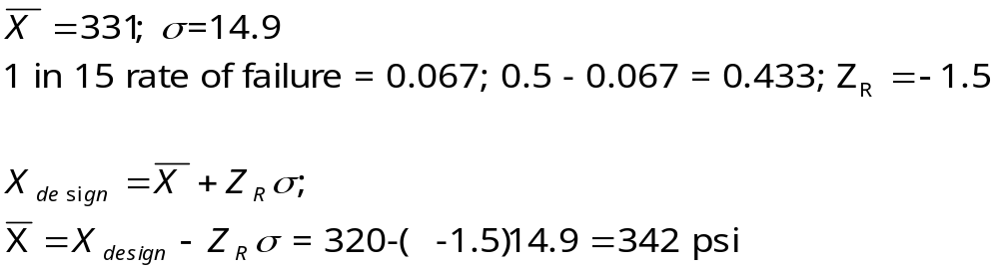
Solution

Slide 42
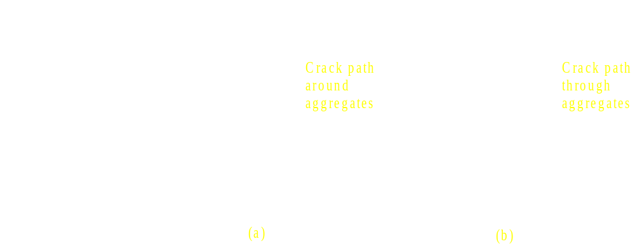
Crack Growth

Slide 43
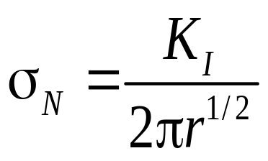
Stress Intensity Factor
y
a
x
Crack Tip
Stress Distribution

Slide 44
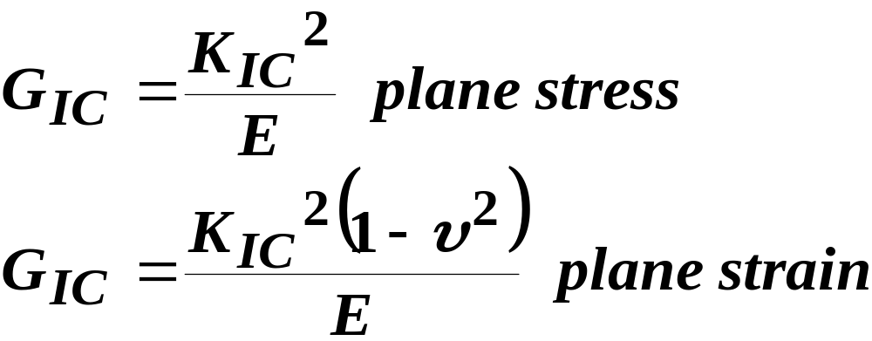
Fracture Mechanics
K_{I} = stress intensity factor = Fσ(πC)^{1/2}
  F is a geometry factor for specimens of finite size
K_{I} = K_{IC} OR G_{I}=G_{IC} unstable fracture
K_{IC}= Critical Stress Intensity Factor
= Fracture Toughness
G_{I}=strain energy release rate (G_{IC}=critical)

Slide 45
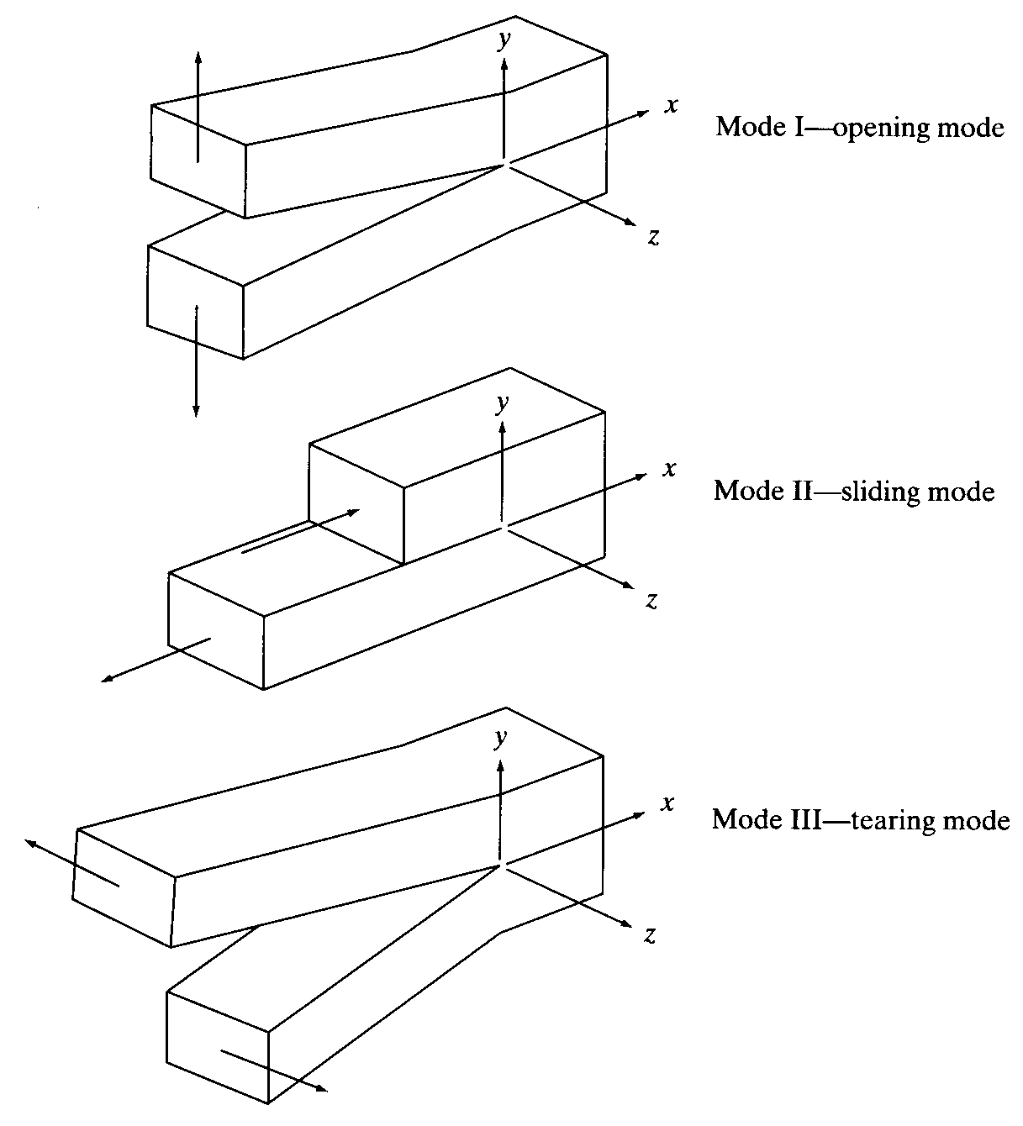
Fracture Mechanics
Three modes of crack opening
Focus on Mode I for brittle materials

Slide 46
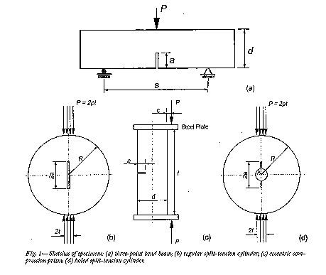

Slide 47

2 d
c
K_{I}
c
2 a
Alpha = a/d
F
Alpha

Slide 48
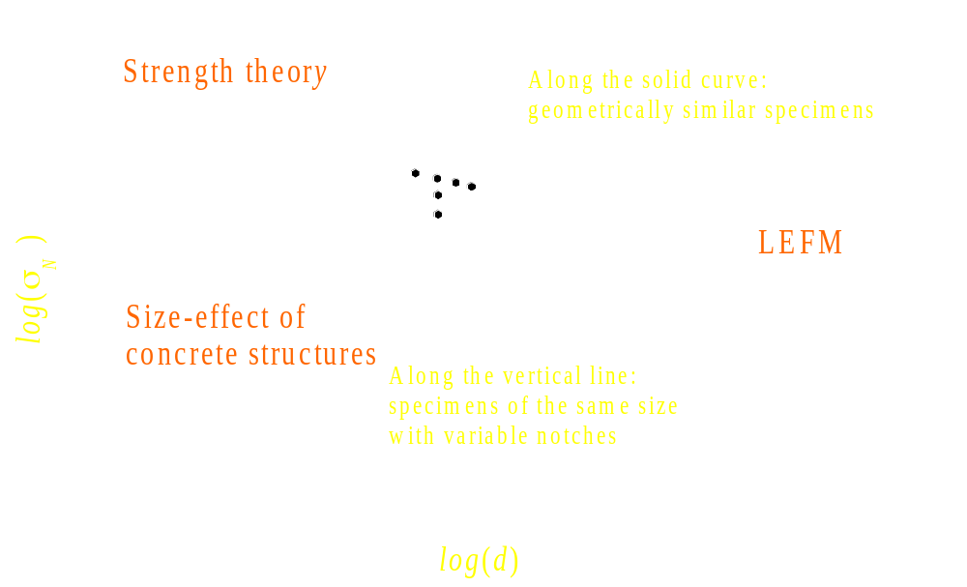
Failure Criterion

Slide 49
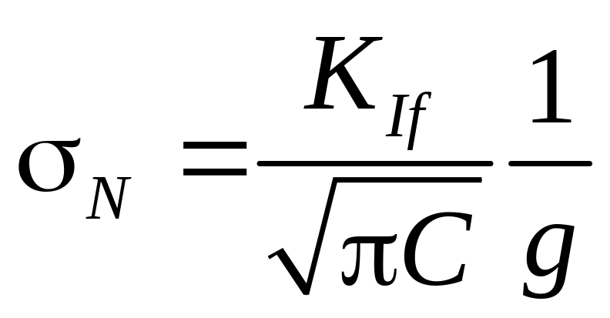
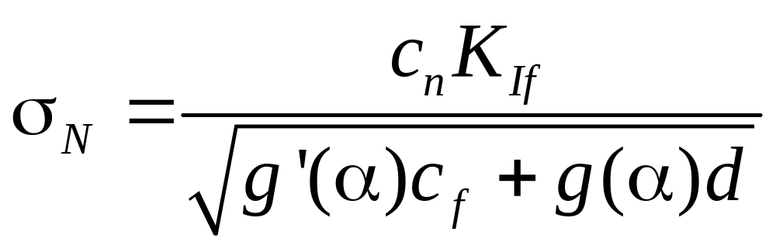
Linear Fracture Mechanics
Non-Linear Fracture Mechanics

Slide 50
a
c_{f}
Crack
Process
Zone
K_{I}
d
Alpha = a/d

Slide 51
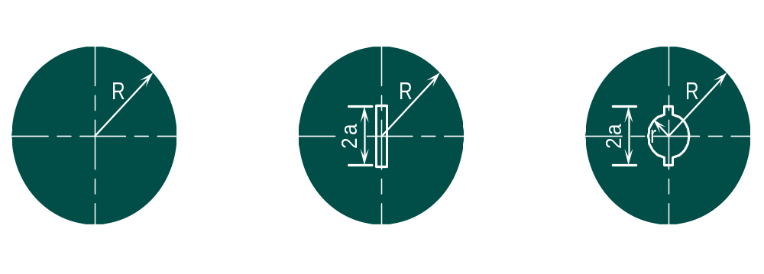
Fracture specimens

Slide 52
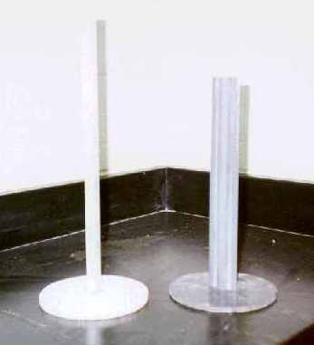
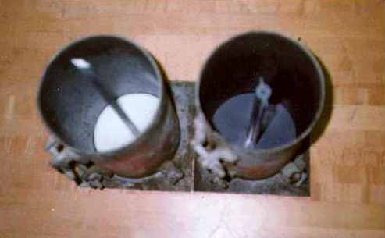
Specimen Apparatus

Slide 53
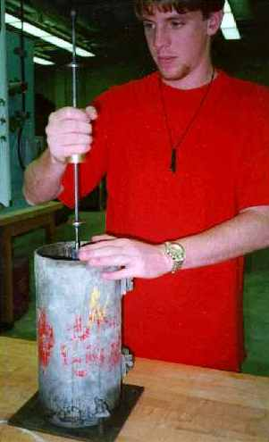
Specimen Preparation

Slide 54
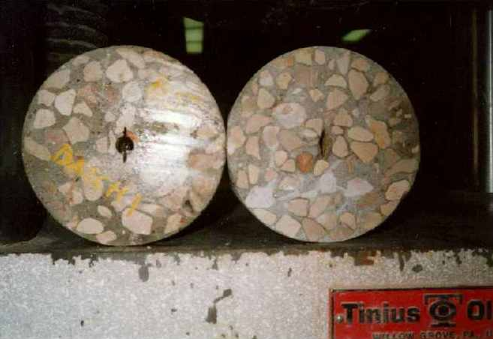
Test Specimens

Slide 55
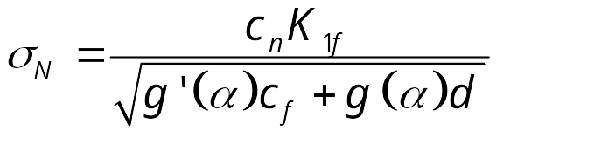
Failure Criterion

Slide 56


Fracture Spread Sheet

Slide 57



Fracture Spread Sheet

Slide 58


Fracture Spread Sheet

Slide 59


Applications of Fracture Parameters
Strength Determination - Beam

Slide 60
Applications of Fracture Parameters
Strength Determination
Size effect on strength
( α₀ = 0.2; B_{fu} = 3.9 MPa = 566 psi; d_{a} = 25.4 mm = 1 in)
log (d/d_{a}) Specimen or structure size log (σ_{N} / B_{fu}) σ_{N}
d (mm or inch) (MPa or psi)
0.70 127 or 5 - 0.18 2.57 or 373
1.00 305 or 12 - 0.26 2.15 or 312
1.30 507 or 20 - 0.35 1.75 or 254

Slide 61

Durability

